Slide 1
Dual Sheet Meshing: An Interactive Approach to Robust Hexahedralization
Kenshi Takayama
takayama@nii.ac.jp
National Institute of Informatics

Slide 2
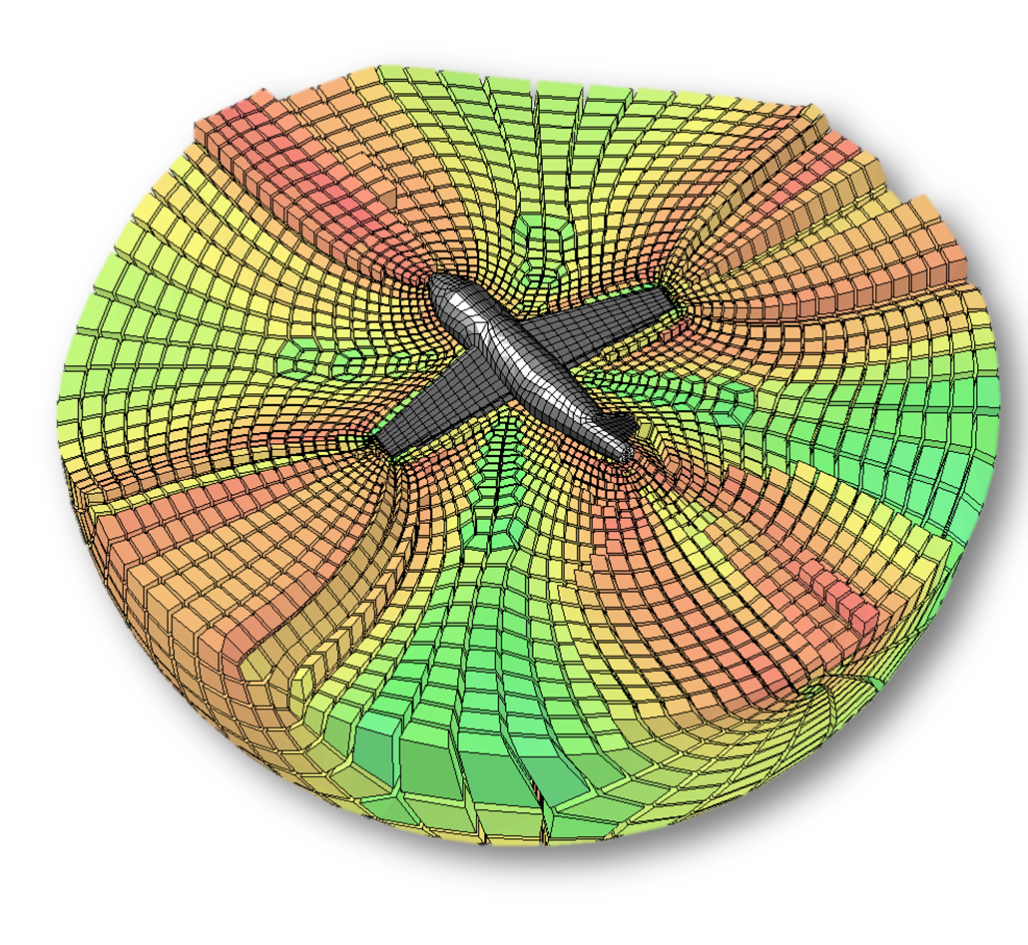
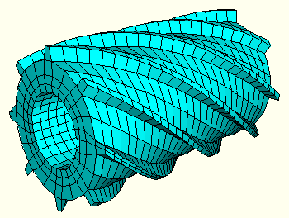
Hexahedral meshes
Needed for running numerical simulations on 3D shapes
Notes:
Hexahedral meshes, or hex meshes, are needed for running numerical simulations on 3D shapes.

Slide 3
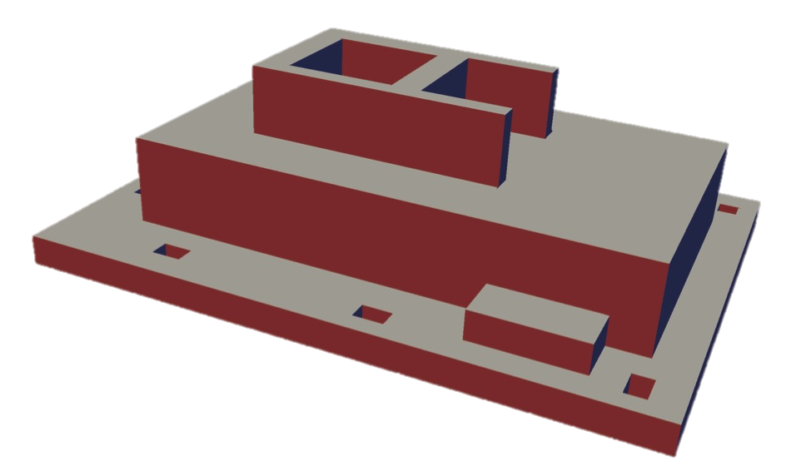
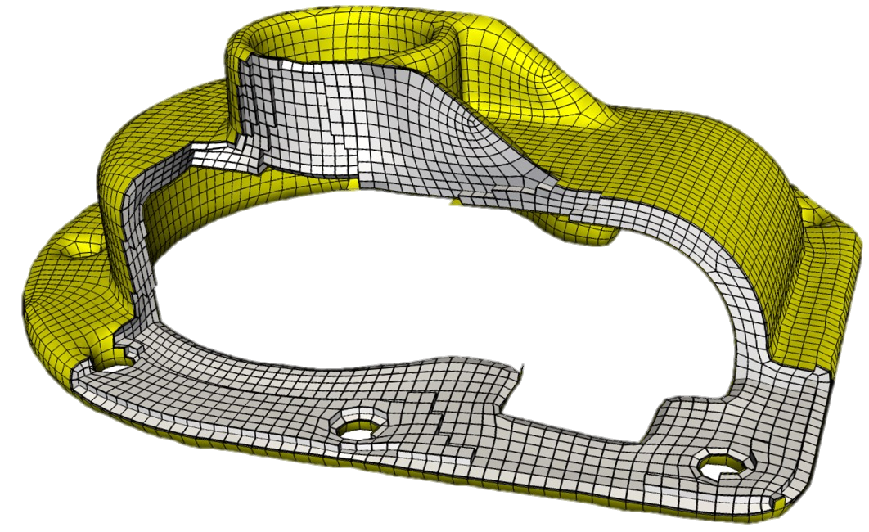
State-of-the-art (1/2): PolyCube mapping
[Gregson et al. 11, Huang et al. 14, Fang et al. 16]
✔ Robust
✗ Not general enough
(Interior always forced to become regular grid)
Notes:
There are mainly two popular approaches for generating hex meshes.
One is based on PolyCube mapping, where the input 3D geometry is deformed such that the face normals are aligned to one of the coordinate axis directions, then the interior is meshed with a regular grid.
Such a regular grid is then mapped back to the original shape, to generate the final hex mesh.
This approach is fairly simple and robust, but the downside is that it’s not general enough because the interior of the mesh is always forced to become a regular grid, which may be unsuitable for certain cases.

Slide 4
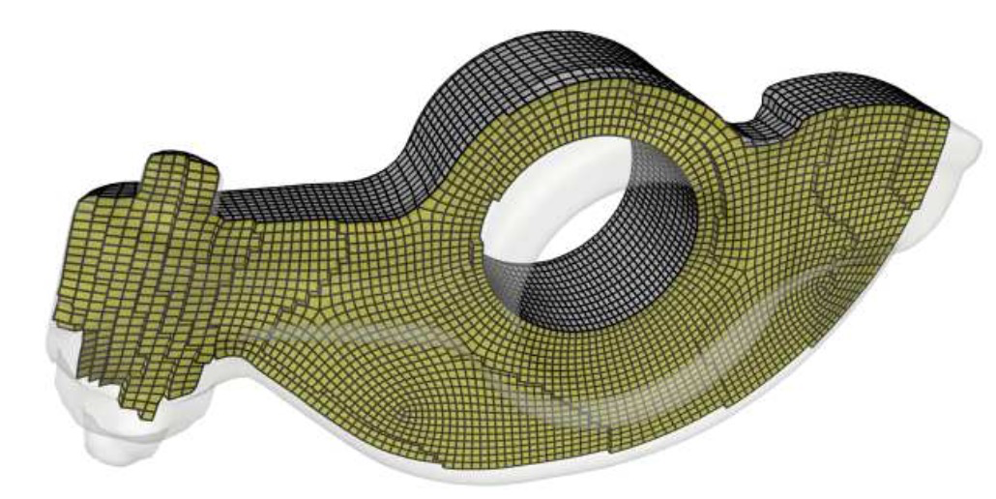
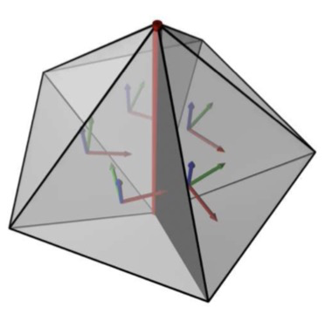
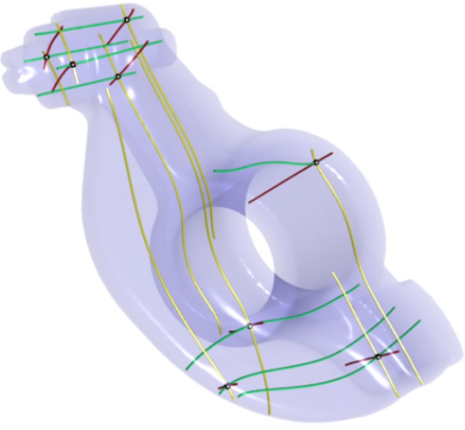
State-of-the-art (2/2): Field-guided parameterization
[Nieser et al. 11, Huang et al. 11, Li et al. 12, Jiang et al. 14, Lyon et al. 16, Solomon et al. 17, Liu et al. 18]
Our goal: robustness & generality
✔ General & high-quality
(Interior NOT forced to become regular grid)
✗ Often fails
(Due to inadmissible types of field singularity)
Notes:
The other promising approach is based on field-guided parameterization.
It first generates a smooth field of 3D orientations inside the volume that conforms to the boundary surface, then constructs an integer grid map, then finally traces the integer isolines of the map to get the final hex mesh.
This approach is general and can achieve high-quality, because the interior is not forced to become a regular grid.
The downside, however, is that the process may fail due to inadmissible types of field singularity.
Given this literature, our goal is to achieve robustness and generality at the same time.

Slide 5
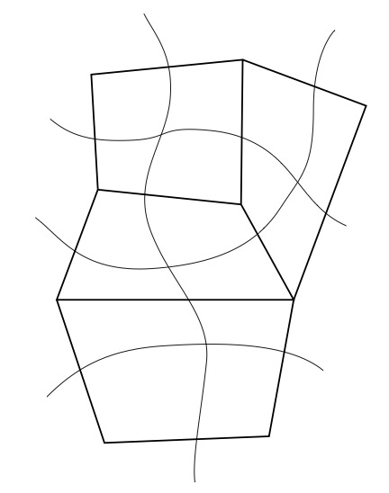
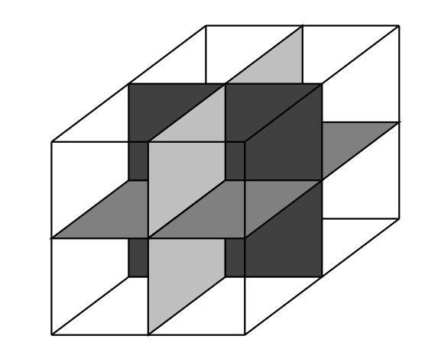
Dual of quad/hex mesh
Images courtesy of [Eppstein 96]
Connect midpoints of opposite edges
➔ Arrangement of curves
Intersection of 2 curves == one quad
Connect midpoints of “parallel” edges
➔ Arrangement of surfaces
Intersection of 3 surfaces == one hex
Notes:
The key to achiving our goal is the dual perspective for quad or hex meshes.
For quad meshes, the dual structure is obtained by connecting midpoints of opposite edges, leading to an arrangement of curves intersecting with each other.
From the dual perspective, an intersection of 2 curves defines one quad face.
Similarly, for hex meshes, the dual structure is obtained by connecting midpoints of “parallel” edges of each hex cell, leading to an arrangement of surfaces intersecting with each other.
From the dual perspective, an intersection of 3 surfaces, or sheets, defines one hex cell.

Slide 6
Inspiration: dual-based quad meshing
[Campen et al. 12, Campen & Kobbelt 14]
Dualize
Generate enough loops (greedy [2012], controllable [2014])
Take dual ➔ quad mesh
Let’s take this to 3D!
Notes:
Our work is directly inspired by dual-based quad meshing methods proposed by Campen et al., where given an input 3D geometry, they generate enough set of loops on the surface, then take the dual of the loop configuration to arrive at a quad layout, which is then subdivided to produce the final quad mesh.
So our basic motivation was to simply take this approach to 3D.

Slide 7
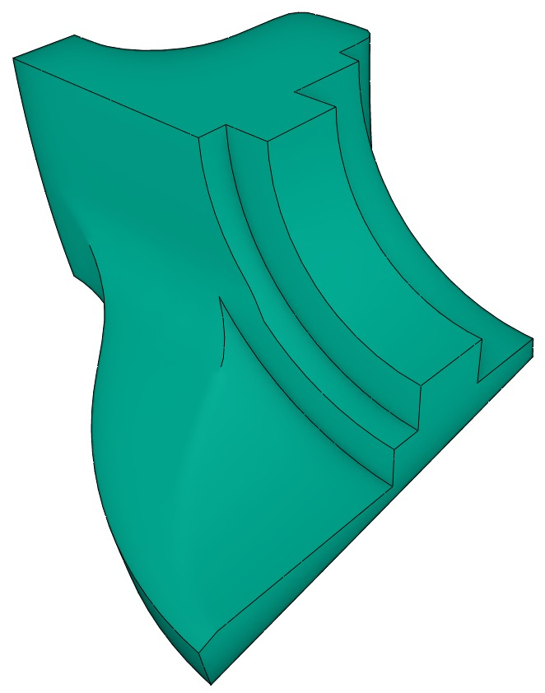
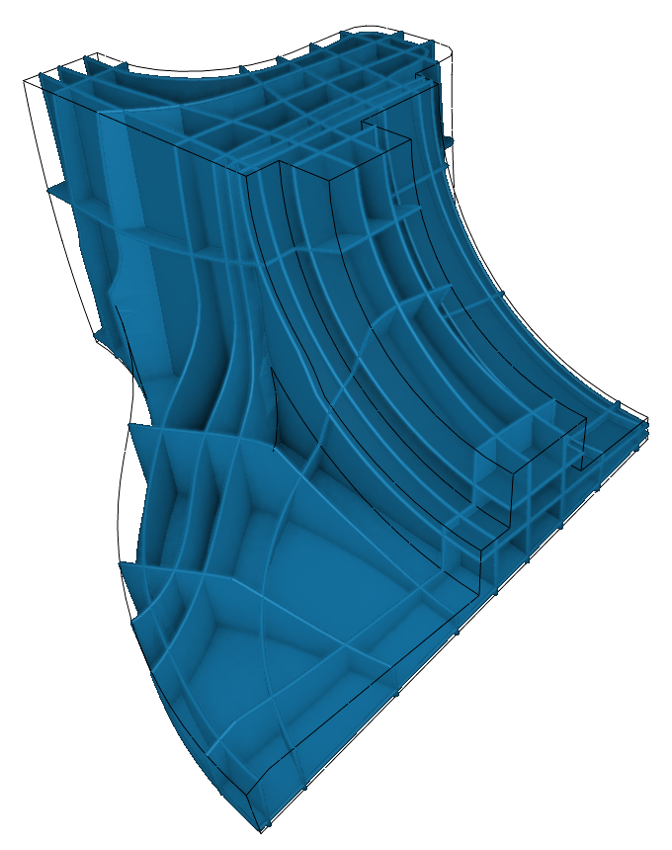
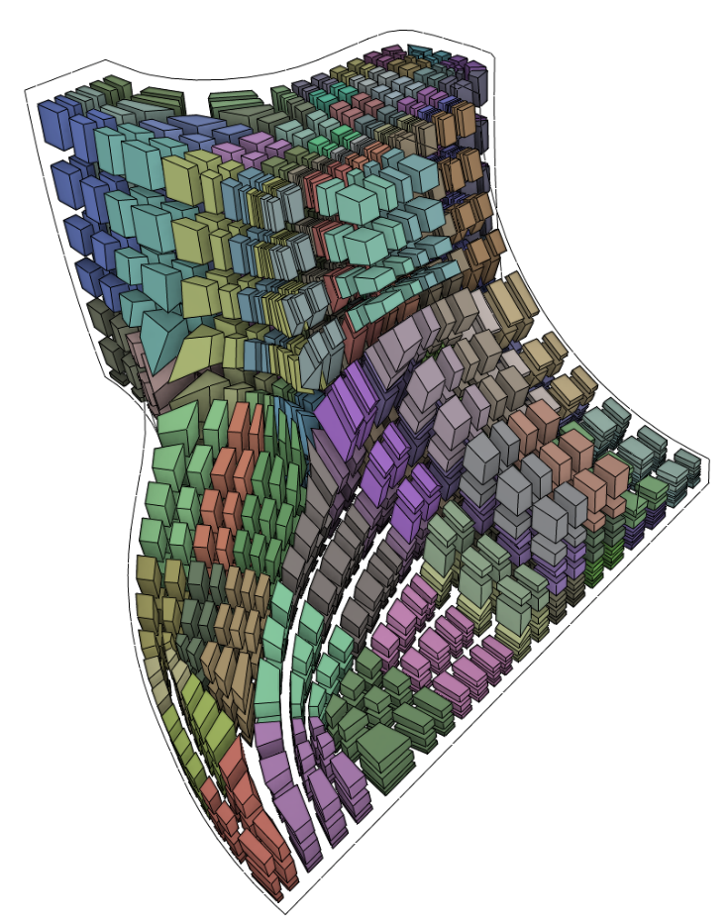
Our work: dual-based hex meshing
Dualize
Generate enough sheets somehow
Take dual ➔ hex mesh
How?
Notes:
So our work is dual-based hex meshing where given an input 3D geometry, we generate enough set of sheets “somehow”, then take the dual to get the final hex mesh.
And of course, the question is how we actually generate such sheets.

Slide 8
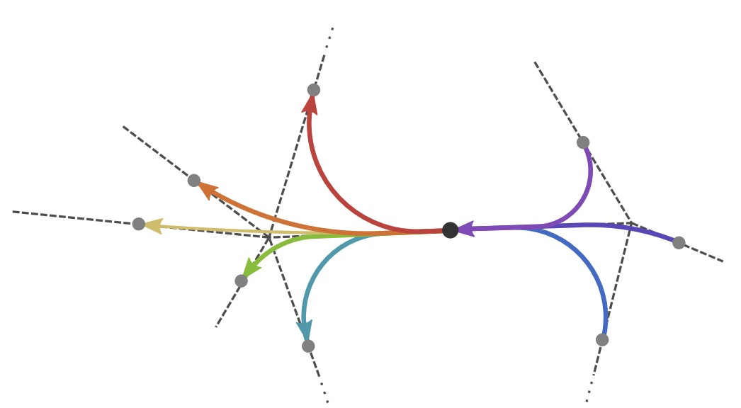
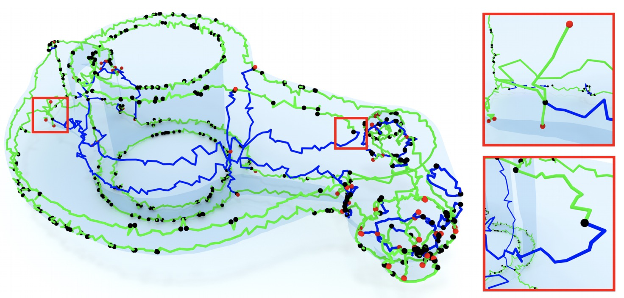
Automatically generating dual sheets seems hard!
Campen et al.’s method not generalizable to 3D:
[Campen & Kobbelt 14]
[Liu et al. 18]
Anisotropic geodesic can find 1-manifolds only
Field singularity is much more complex & noisy
Notes:
And here’s a bad news: it turns out that automatically generating dual sheets seems very hard!
This is because Campen et al.’s method does not easily generalize to 3D.
One major issue is that the anisotropic geodesic they rely on can only be used for finding 1-manifold, or linear structures, while we’re intersted in finding 2-manifold, or surface structures.
Another issue is that the singularity of the 3D orientation field tends to be much more complex and noisy, which makes it hard to design an algorithm that relies on the configurations of singularities.

Slide 9
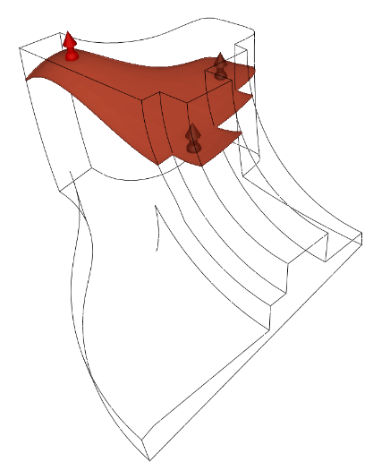
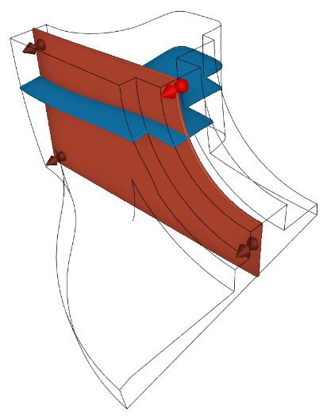
Our approach: manual 3D modeling
Dualize
Notes:
So instead, our approach is to rely on manual 3D modeling; the user manually creates sheets one by one until there are enough of them, which are then dualized to produce a valid hex mesh.

Slide 10
Talk outline
1. User interface
2. Algorithm
Dualize
Notes:
As such, in this talk, I’ll first explain the user interface for creating dual sheets, then explain the alrogithm to actually compute the dual of the sheets and generate the hex mesh.
So let’s get to the user interface part.

Slide 11
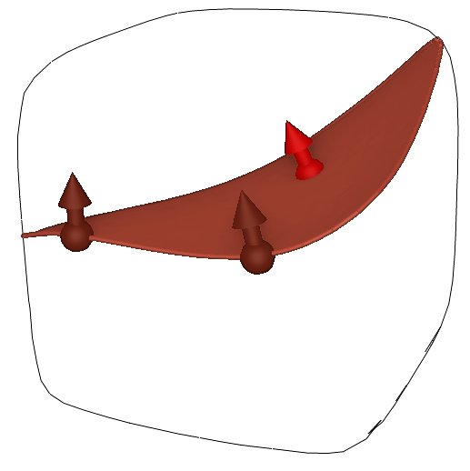
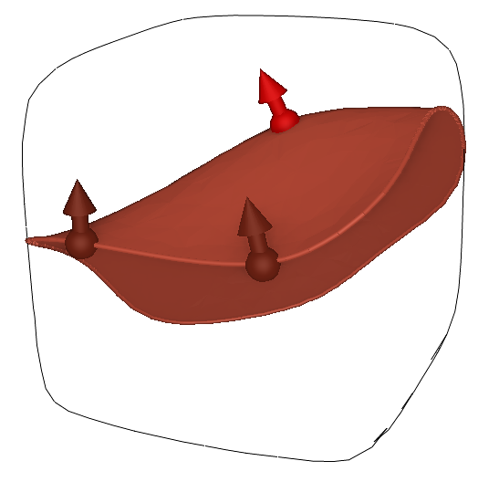
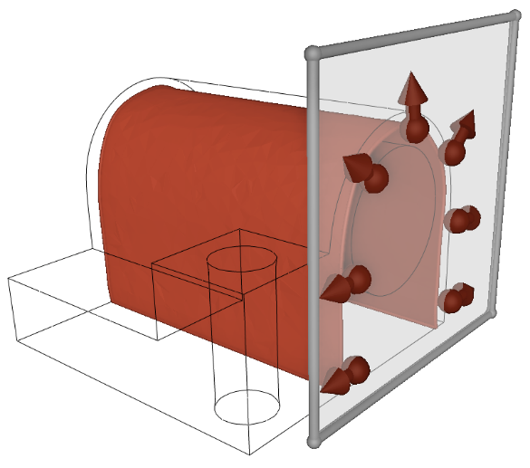
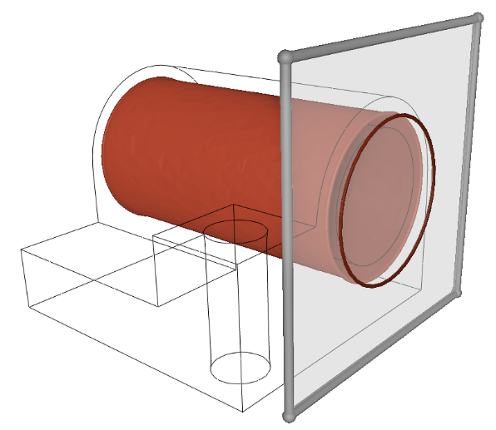
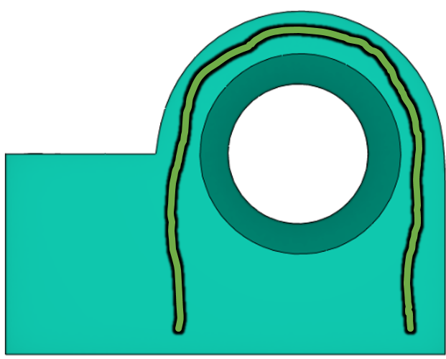
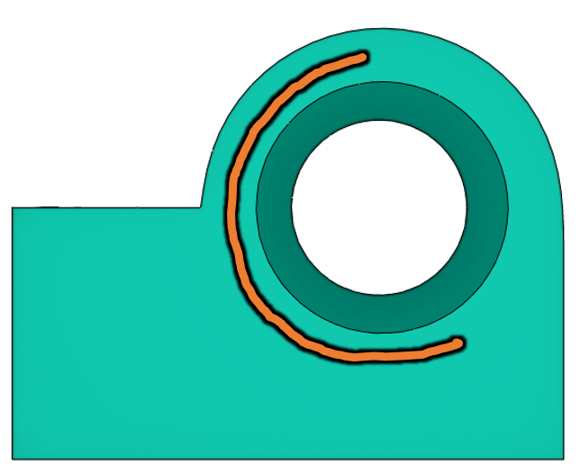
3 tools for creating sheets
Freeform tool
Demo
2D Sketch tool
Cylinder tool
Notes:
Our system has 3 basic tools for creating sheets.
The first one is Freeform tool where the user creates point & normal constraints, and the system generates a smooth interpolating surface.
The second one is 2D sketch tool where the user simply draws a stroke on the screen which gets extruded along the viewing direction to generate a cross-sectional surface.
The last one is Cylinder tool which is similar to 2D sketch tool except that the 2D profile curve is assumed to be a circle.
Let’s move on to demo.

Slide 12
3 tools for creating sheets
Freeform tool
2D Sketch tool
Cylinder tool

Slide 13
Talk outline
1. User interface
2. Algorithm
mesh
vertices
edges
faces
cells
M = (V, E, F, C)
Dualize
2. Geometry
1. Topology
Notes:
Next I’ll explain our algorithm to turn the sheet configuration into a final hex mesh.
A hex mesh consists of vertices, edges, faces and cells.
The latter three are the topology part of the mesh which we generate first.
The geometry part, or the vertex positions, are generated afterwards.

Slide 14
Generating topology (1/2): find sheet intersections
Design decision: represent sheets as zero-isosurfaces
Piecewise-linear over tet mesh
➔ makes finding sheet intersections very easy
f₁
g₁
h₁
1
f₂
g₂
h₂
1
f₃
g₃
h₃
1
f₄
g₄
h₄
1
λ₁
λ₂
λ₃
λ₄
0
0
0
1
f₁
g₁
h₁
g=0
h=0
f₄
g₄
h₄
f=0
f₂
f₃
g₂
g₃
h₂
h₃
Notes:
The first step of generating the topology is finding all the intersections among sheets.
Here we make a notable design decision, which is to represent sheets as zero-isosurfaces of scalar implicit functions.
And we use piecewise-linear tet mesh discretization for the implicit functions.
This makes finding sheet intersections very easy, which works as follows:
Let’s say 3 sheets are intersecting in the same tet, where the scalar functions are denoted by f, g, and h and sampled at the 4 vertices of the tet.
Then, the intersection location can be obtained as a barycentric coordinate by solving this 4x4 matrix.

Slide 15
Generating topology (2/2): build connectivity
+
−
+
−
Vertex code: array of signs
Cell code: two digits set to 0
Derives 4 vertex codes by substituting all possible sign combinations:
{ (+ +), (+ –), (– +), (– –) }
Call add_cell() for each cell code
1
–
2
+
3
+
4
+
1
–
2
+
3
–
4
+
1
–
2
+
3
–
4
–
−
#1
– +
1
0
2
+
3
0
4
+
– –
1
0
2
+
3
–
4
0
+
+ +
+ –
1
+
2
+
3
+
4
+
1
+
2
+
3
–
4
+
1
+
2
+
3
–
4
–
+
#2
1
+
2
0
3
0
4
+
1
+
2
0
3
–
4
0
−
1
+
2
–
3
+
4
+
1
+
2
–
3
–
4
+
1
+
2
–
3
–
4
–
#3
#4
Notes:
After finding all the intersections among sheets, the next step is to actually build the full mesh connectivity.
I’ll explain how it works using a 2D example as shown here.
Let’s say we have a sheet #1 going here, whose scalar function takes positive values on the lower half and negative values on the upper half.
And let’s say we have 4 such sheets in this example.
The domain is now divided by the sheets into distinct subregions.
Note that each subregion corresponds to a vertex in the hex mesh.
Now let us define a vertex code for each subregion, as an array of signs of those sheets’ implicit functions.
For example, for this subregion on the top left, sheet #1 is negative, #2 is positive, #3 is positive and #4 is positive, so this is its vertex code.
This way, each subregion is assigned a unique vertex code.
We can define a cell code similar to a vertex code except that two digits are set to zero.
These digits correspond to the sheets involved in the intersection.
A useful observation here is that a cell code can derive the codes of its constituting 4 vertices by substituting all possible sign combinations.
For example, by substituting – and +, we get the vertex code for the top left, and so on.
We call the add_cell() function in the OpenVolumeMesh library for each cell code.
This way, the hex mesh topology can be easily generated.

Slide 16
Generating geometry
Campen et al.’s approach:
Generate irregular vertex in each irregular dual face
Trace separatrices using anisotropic geodesic
Intersect separatrices as regular vertices
Parameterize each quad domain
Not generalizeable!
Notes:
Now I’ll explain how we generate the geometry.
But before doing so, let us review Campen et al.’s approach:
First, they generate an irregular vertex in each irregular dual face.
Then they trace separatrices starting from those irregular vertices using the anisotropic geodesic algorithm.
Then they take intersections among separatrices and treat them as regular vertices.
And finally they parameterize each quad domain using harmonic parameterization.
The problem here for us is, that the anisotropic geodesic algorithm they rely on doesn’t generalize to 3D, so we can’t use their approach for the 3D case.

Slide 17
Generating geometry
Our approach:
Map each dual face onto a regular polygon using harmonic parameterization
Generalizeable to 3D
In 2D, map to regular N-gon
In 3D, map to ? _
Notes:
So we use a bit different approach: we simply map each dual face onto a regular polygon using harmonic parameterization.
For example, for this dual face on the bottom left, it’s a triangular domain, so we map it onto a regular triangle in the parameter space.
We can also easily generate a quad mesh inside the domain.
Note that an irregular vertex is generated inside the domain.
Likewise, for the dual face next to it, it’s a rectangular domain, so we map it onto a square, and the same for the dual face on the top left.
For the dual face on the top right, it’s a pentagonal domain, so we map it onto a regular pentagon.
This approach seems easily generalizable to 3D, except it’s not immediately clear to us what the target geometry should be for the harmonic parameterization.
In 2D, we map each dual face onto a regular N-gon, but in 3D, what do we map each dual cell onto?

Slide 18
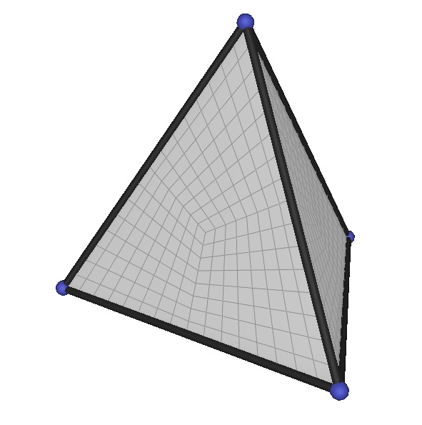
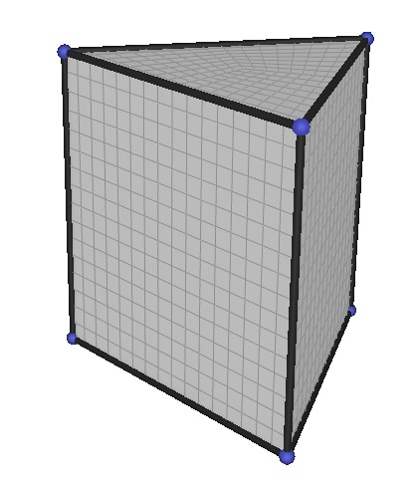
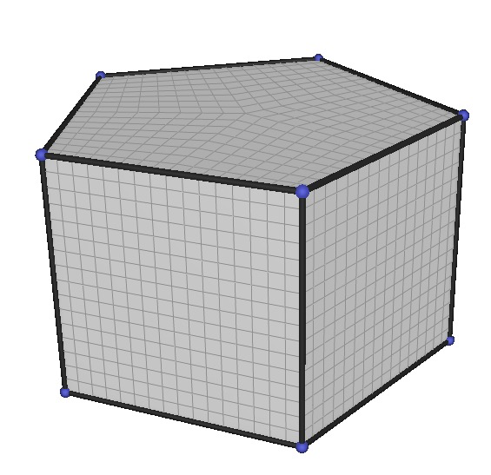
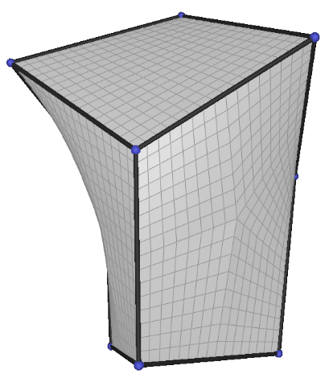
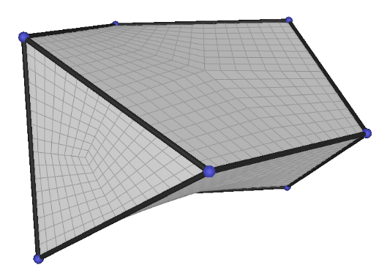
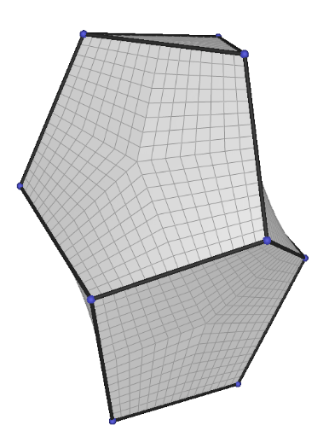
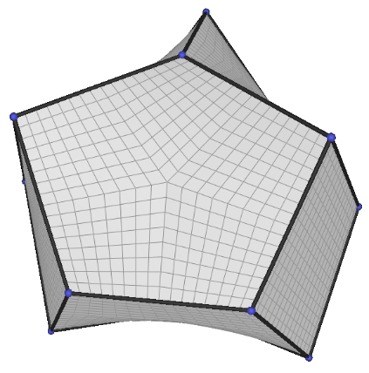
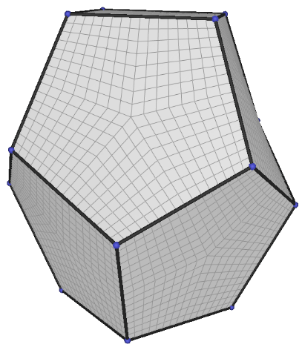
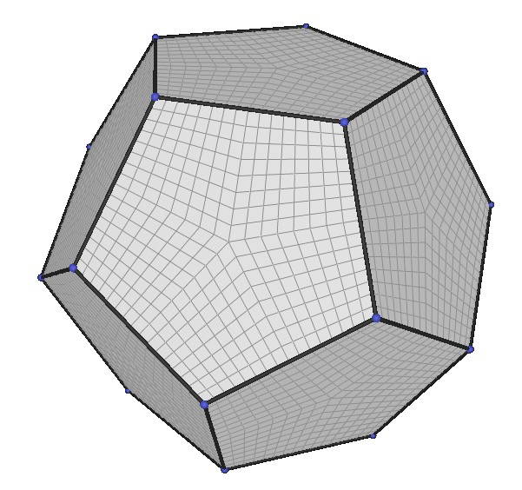
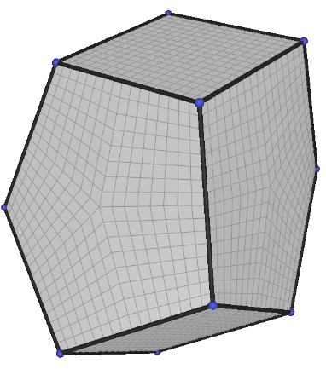
Useful observation in [Liu et al. 18]
Assume:
“Every edge valence is {3, 4, 5}”
All vertex topologies fall into only 11 types!
Assume:
“Every dual face is {3, 4, 5}-gon”
All dual cell topologies fall into only 11 types! ➔ reference polyhedra
Dual
(4,0,0)
(2,3,0)
(2,2,2)
(0,5,2)
(1,3,3)
(4,0,0)
(2,3,0)
(2,2,2)
(0,5,2)
(1,3,3)
(0,4,4)
(2,0,6)
(0,3,6)
(0,2,8)
(0,0,12)
(0,4,4)
(2,0,6)
(0,3,6)
(0,2,8)
(0,0,12)
(Regular topology (0,6,0) omitted)
Notes:
Here comes in a very useful observation made in Liu et al.s paper published last year, which states as follows:
Assuming that every internal edge of a hex mesh has valence of either 3, 4, or 5, all the internal vertex topologies fall into only 11 types!
We use a dual of this observation in our algorithm; that is, assuming that each dual face is topologically triangular, retangular, or pentagonal, all dual cell topologies fall into only 11 types.
We call such 3D shapes reference polyhedra, and generated their geometry using some simple algorithm.
We use them as the target geometry for the harmonic parameterization.

Slide 19
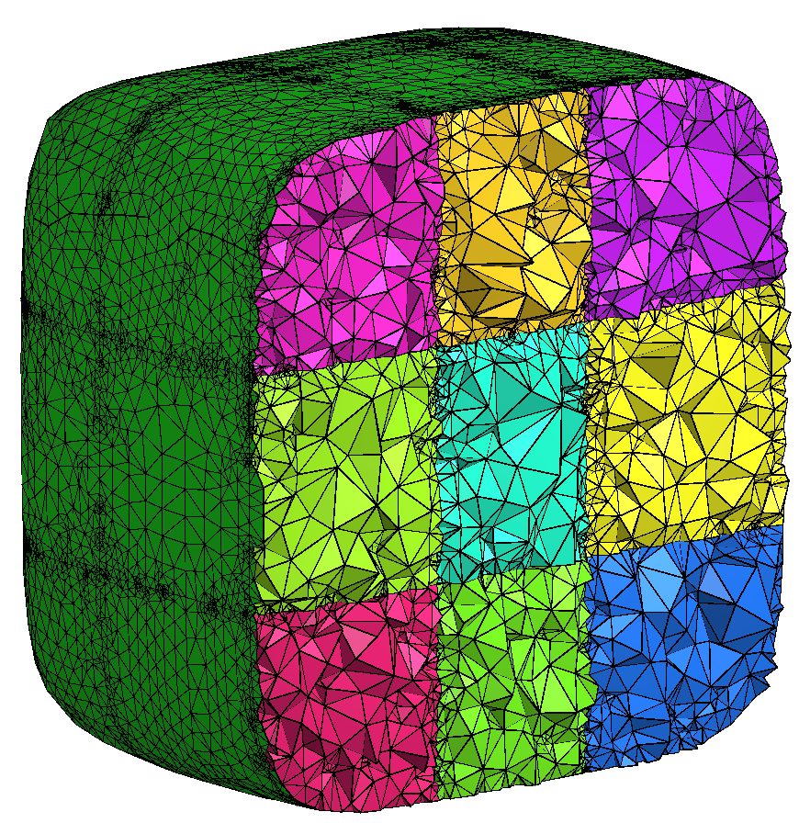
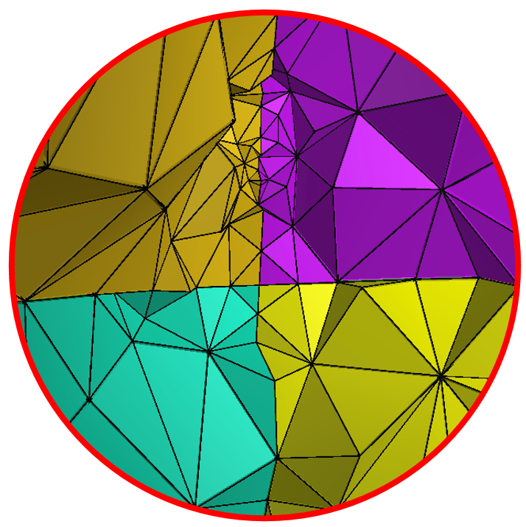
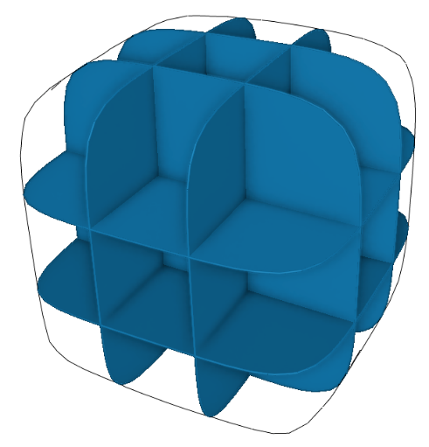
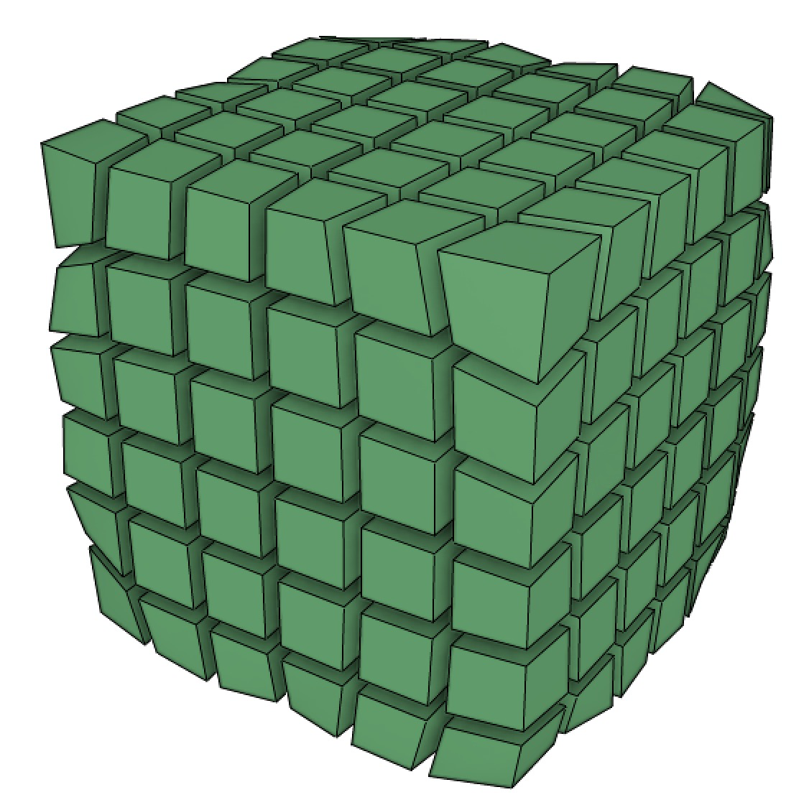
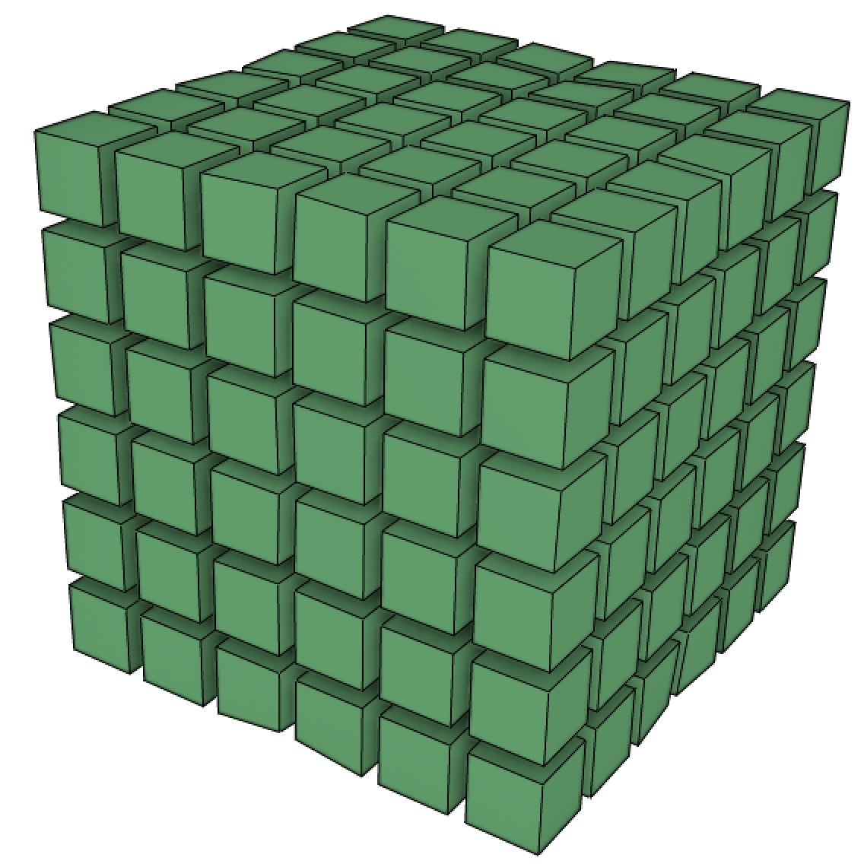
Implementation details
Volume discretized by tet mesh
Conforming to sheet intersections
Preservation of sharp features
By modifying boundary conditions
Notes:
Here are some implementation details.
As usual, we discretize the volume using a tet mesh.
Importantly, this tet mesh must conform to all the sheets and the intersections between sheets.
Also, our algorithm can esaily support preservation of sharp features, by modifying the boundary conditions of the harmonic parameterization.
Please refer to the paper for more details.

Slide 20
Results

Slide 21
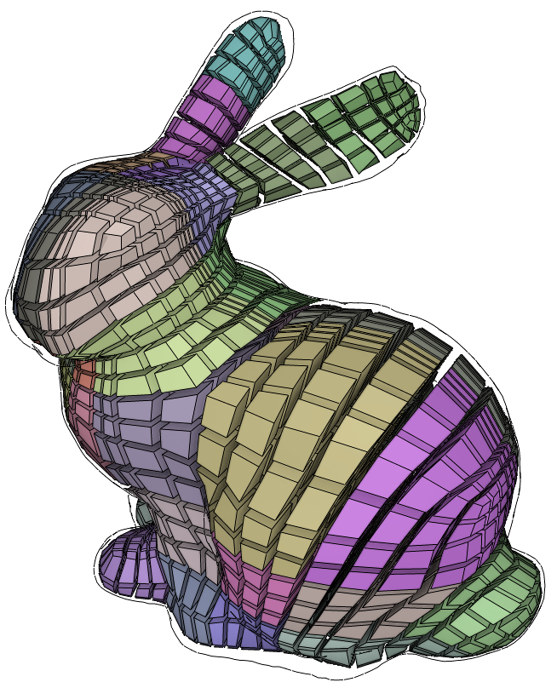
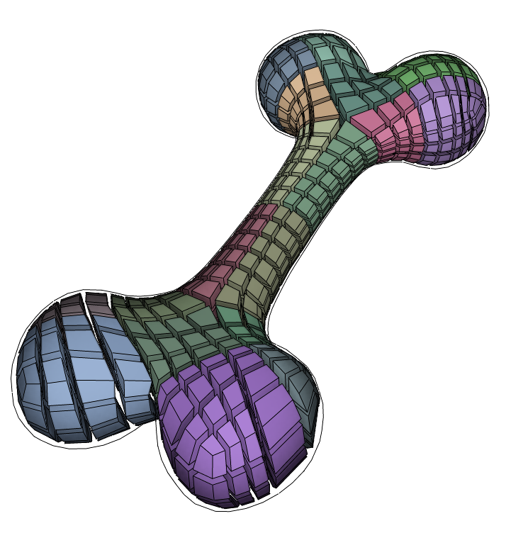
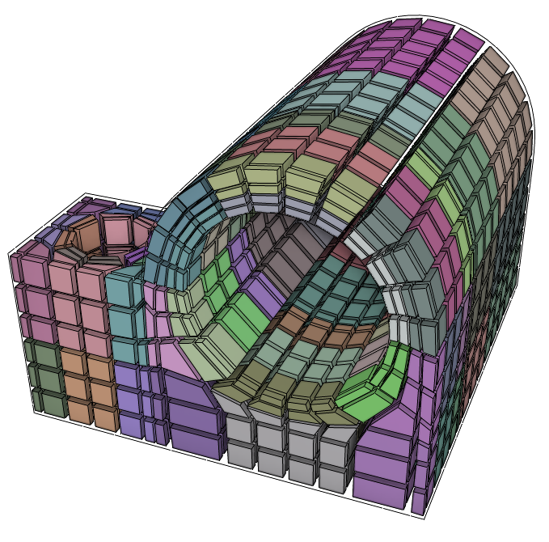
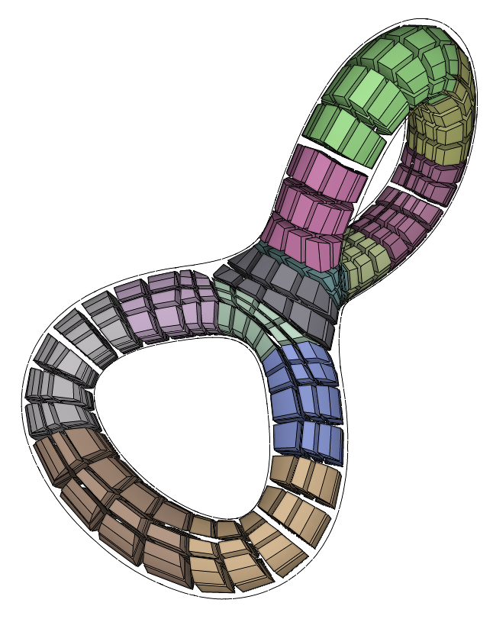
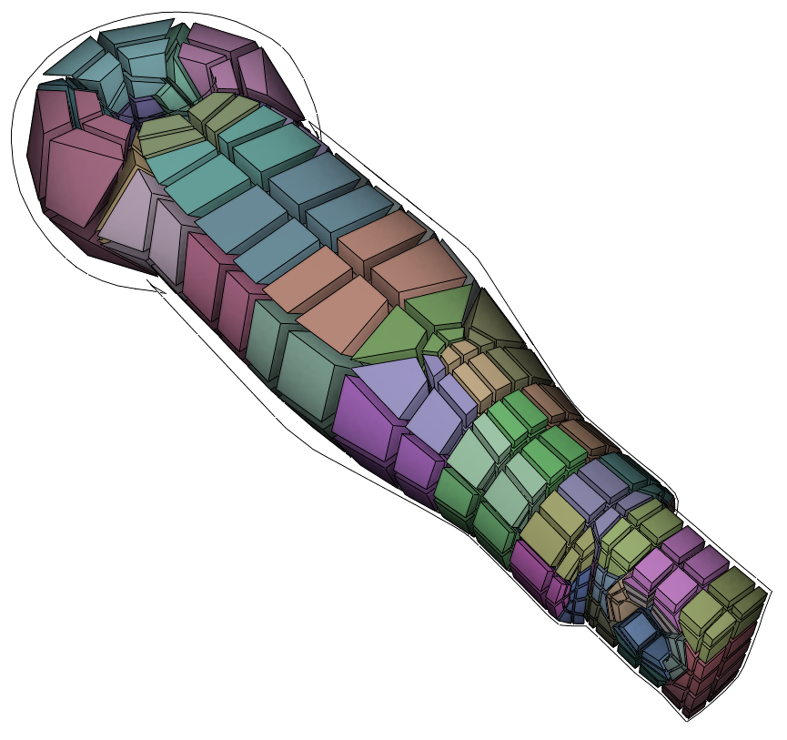
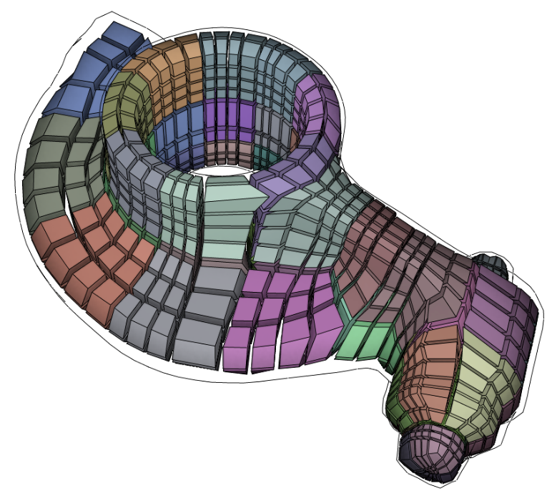
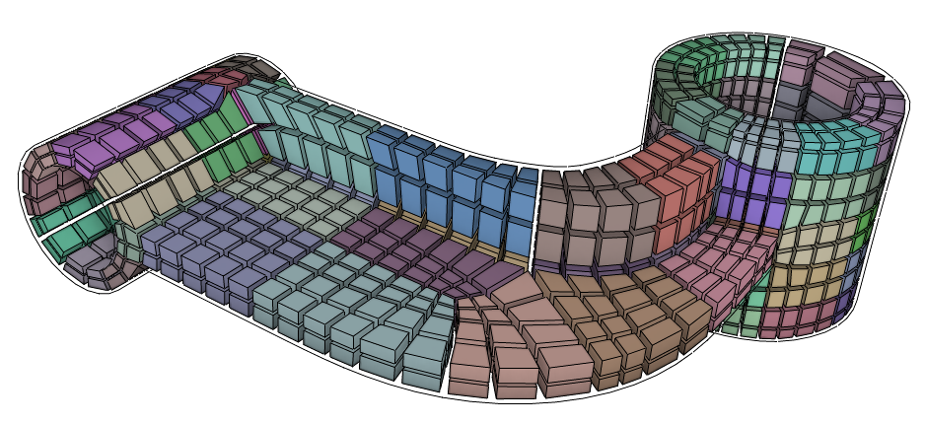
BUNNY
JOINT
BONE
DOUBLE
TORUS
ROD
ROCKARM
All created by me
A few hours for 3D modeling
3~5 min for dualization
HANGER
Notes:
OK, here are some results, all created by myself.
Each of them took me about a few hours of 3D modeling.
Although the sheet creation process is interactive, the mesh generation part is not that fast currently, typically taking 3 to 5 minutes.
This is to be improved in the future.

Slide 22
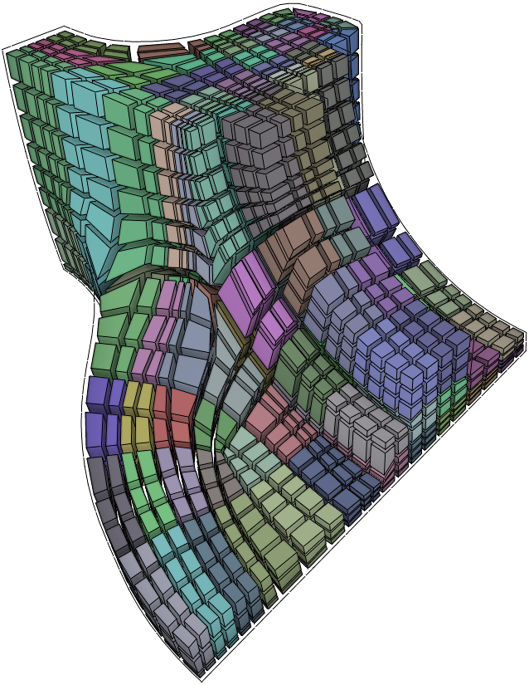
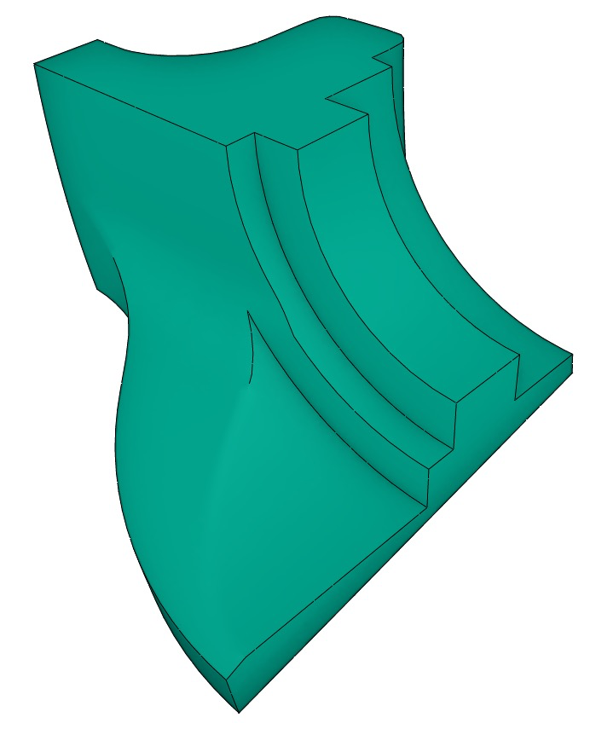
Use case: edit existing topology
Edit sheets
Notes:
An interesting use case enabled by our approach is the editing of an existing hex mesh topology.
Given an existing hex mesh, the user can enforce additional feature preservation constraint by editing the sheets accordingly.

Slide 23
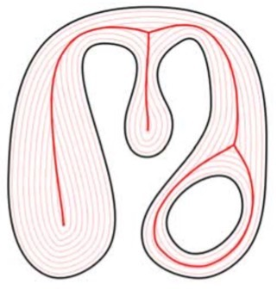
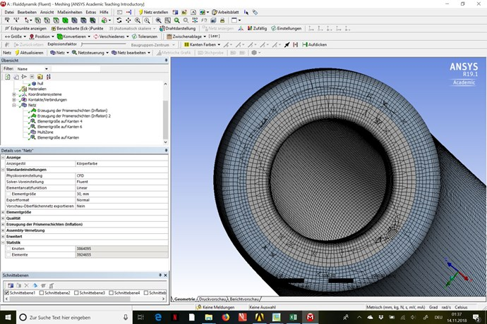
Limitations & future work
Self-intersecting sheets
Currently not possible due to implicit representation
More intelligent sheet creation
Geometric cues (e.g., skeletons)
Partial automation (machine learing…?)
User study
Comparison against commercial tools
ANSYS®
Notes:
Our work has quite some limitations and avenues for future work, obviously.
A major limitation of our system is that self-intersecting sheets cannot be created due to the use of implicit surface representation.
Also, our sheet creation tools are very rudimentary and can be made more intelligenet in various ways.
We could make use of more high level geometric cues such as skeletons.
Also, some kind of partial automation should be possible, perhaps by even utilizing the recently popularized machine learning techniques???
Finally, user study and comparison agasint commercial tools are subjects for future work.

Slide 24
Acknowledgements:
Olga Sorkine-Hornung
Daniele Panozzo
Anonymous reviewers
JSPS KAKENHI (15K15999)
https://bitbucket.org/kenshi84/dual-sheet-meshing
Notes:
I’d like to thank Olga Sorking-Hornung and Daniele Panozzo for their feedback during an early stage of this work.
I’d also like to thank the anonymous reviewers for their insights, and finally to my funding agency.
The code is fully open-sourced and available on this URL.
This concludes my talk, thank you.

Slide 25
Layout previewing

Slide 26
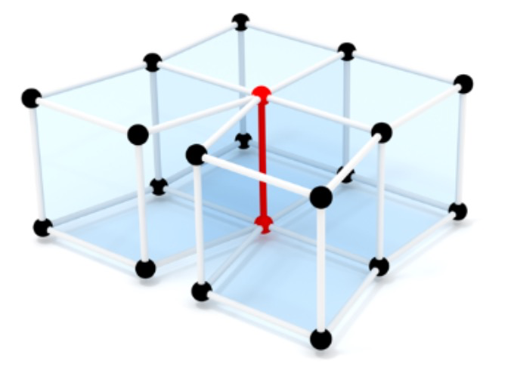
Future work
We exclude boundary edge of valence 4
[Liu et al. 18] supports much wider range of boundary vertex topologies by enumerating significantly more (237) types
We’d need to generate reference polyhedra for those 237 types
[Liu et al. 18]

